Slide 1
connecting people with science
CRISPR Informatics Course
28-Jul-2025 to 01-Aug 2025

Slide 2
CRISPR Informatics Course
Determining Indels generated by CRISPR-Cas9
and
Validation of knock-out / knock-ins
Sandeep Rajan , Technical Specialist
30-Jul-2025

Slide 3
What to expect in this session
The session will cover the following :
Basics of gene editing using CRISPR-Cas9
Brief overview on methods to determine Cas9 induced breaks
Focus on using freeware tool – TIDE to determine editing efficiencies and outcomes
Practical demonstration
Brief overview on using Cas9 to facilitate- gene knock-in / tagging
Practical demonstration
After this session you should be able to :
Use TIDE to determine gRNA efficiency in your cell lines / samples
Understand information contained on sanger sequencing trace files
Determine knock-out/ knock-in/ SNV variations occurring with genomic region of interest

Slide 4
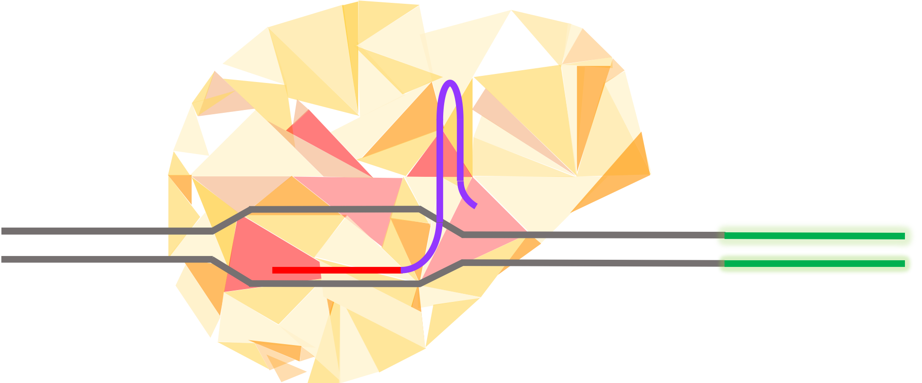
CRISPR-Cas9 editing
Clustered regularly interspaced short palindromic repeats (CRISPR) and CRISPR associated proteins (Cas) derived from microbial adaptive immune system to protect against viruses and plasmids.
Cas9 is the endonuclease that can generate DSB when guided by the target sequence (gRNA)
gRNA / sgRNA is a short synthetic RNA composed of a scaffold sequence necessary for Cas-binding and a user-defined ∼20 nucleotide spacer that defines the genomic target to be modified.
+

Slide 5
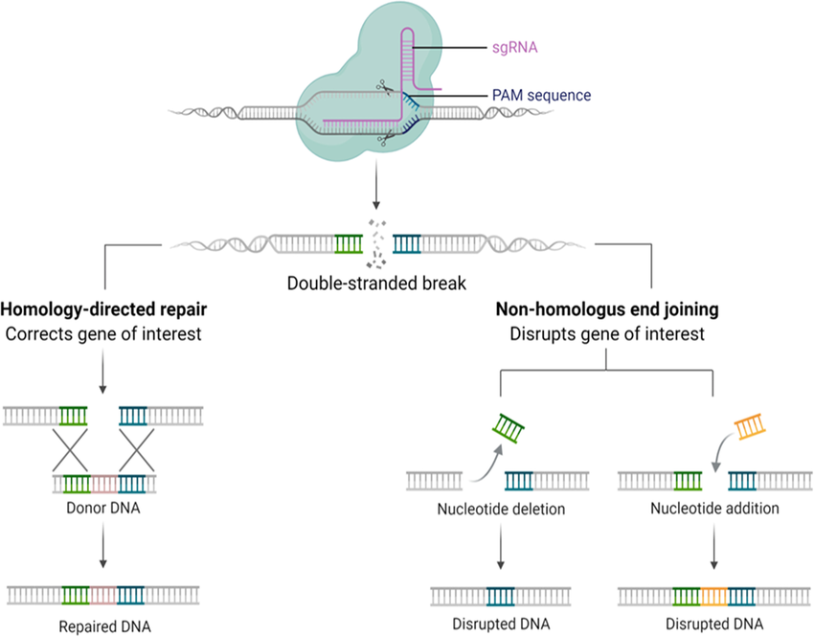
CRISPR-Cas9 editing – Generating Gene KOs
CRISPR-Cas9 system can be used to generate knock-out cell lines. An insertion or deletion induced by a single guide RNA is often used to generate knock-out cells, however, some cells express the target gene by skipping the disrupted exon, or by using a splicing variant, thus losing the target exon.

Slide 6
CRISPR-Cas9 editing – Generating novel lines
CRISPR/Cas9 gene knock-in or gene replacement system is designed to facilitate the insertion, removal, or replacement of a specific gene(s) within a given genome. The site-specific insertion of protein tags, modified promoters, and other regulatory sequences are also possible.

Slide 7
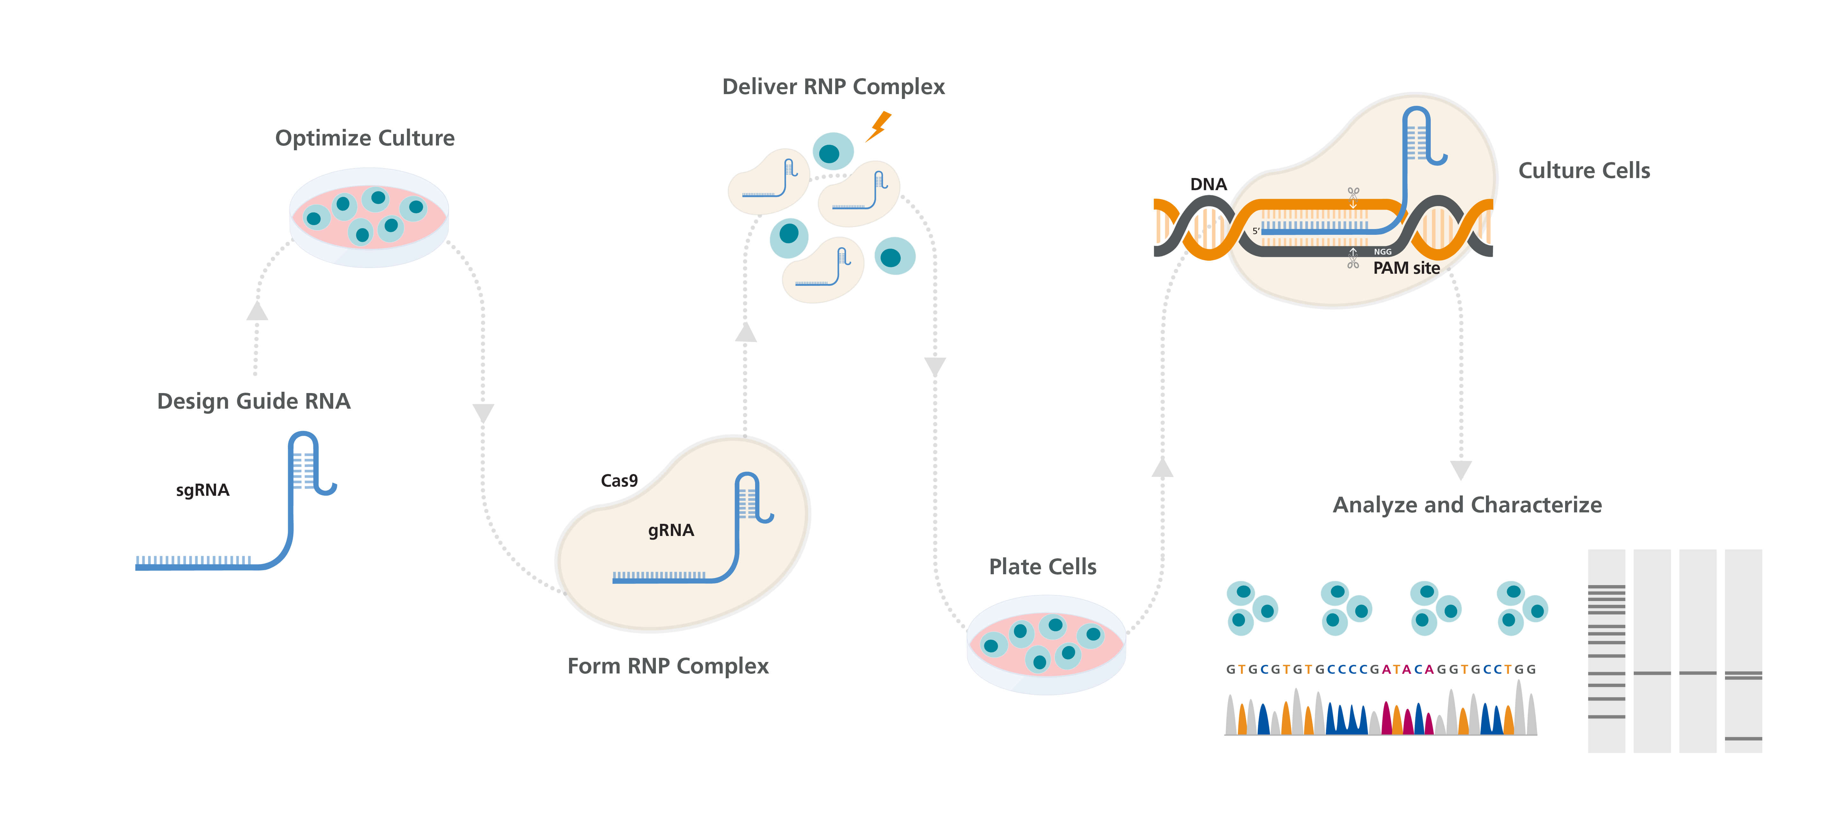
CRISPR-Cas9 edits - how to validate them
The simplest but often the least specific method of identifying successful CRISPR genome editing is to observe phenotypes of edited cells. In some experiments, the expected phenotype from the gene editing process is known.

Slide 8
CRISPR-Cas9 edits - how to validate them
A more in depth view of the genomic edit that translates to the phenotype can be determined by investigating the genetic contact in and around the edited sites.

Slide 9
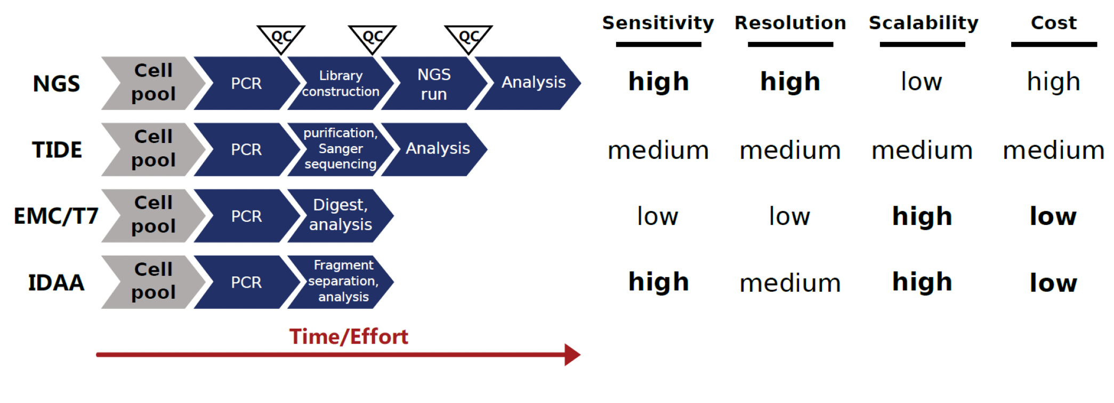
CRISPR-Cas9 edits – what are the methods are available and what do they provide
To determine the edits and its subsequent effects a range of techniques are available

Slide 10
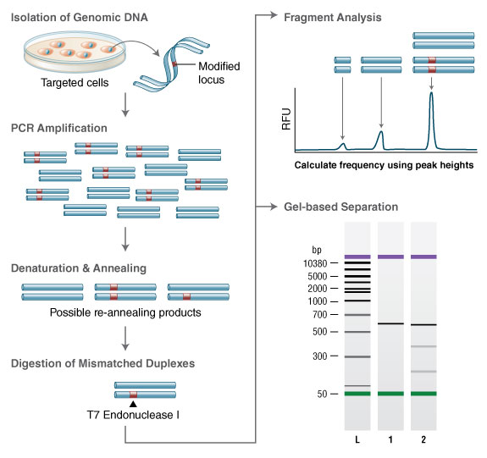
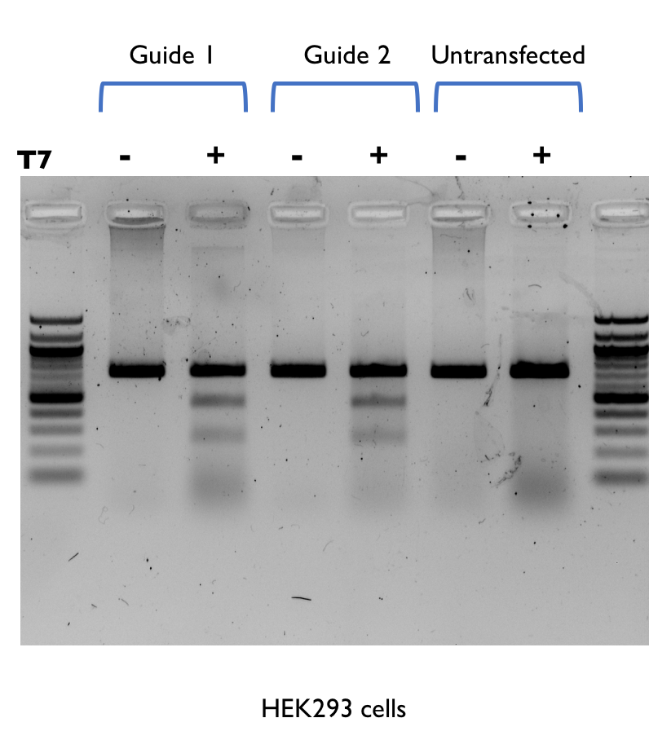
Understanding the outcomes of genome editing
Surveyor nuclease assay
Surveyor nuclease assay is an enzyme mismatch cleavage assay
Can detect single base mismatches or small insertions or deletions (indels).
Surveyor nuclease is part of a family of mismatch-specific endonucleases that were discovered in celery (CEL nucleases).
T7 endonuclease 1
T7 Endonuclease I recognizes and cleaves non-perfectly matched DNA.
PCR products are annealed and digested with T7 Endonuclease I.
Fragments are analyzed to determine the efficiency of genome targeting.

Slide 11
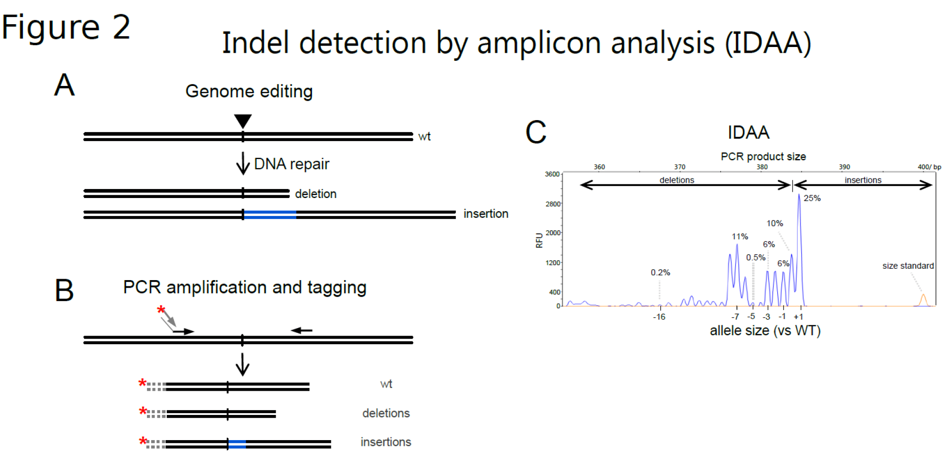
Understanding the outcomes of genome editing
IDAA (Indel detection by Amplicon Analysis)
An alternative non-sequencing based proprietary method that enables sensitive and quantitative detection of InDels.
The methodology is based on a novel tri-primer PCR amplification method and capillary electrophoretic fragment analysis using a standard DNA sequenator instrument.

Slide 12
Understanding the outcomes of genome editing
TIDE – Tracking of Indels by Decomposition

Slide 13
Understanding the outcomes of genome editing
TIDE – Tracking of Indels by Decomposition
TIDE is a simple and accurate assay to precisely determine the spectrum and frequency of targeted mutations generated in a pool of cells by genome editing tools such as CRISPR/Cas9, TALENs and ZFNs.
TIDE requires only standard molecular biology reagents and involves three simple steps:
One pair of standard PCR reactions.
One pair of standard capillary ("Sanger") sequencing reactions.
Analysis of the two resulting raw sequencing files using the TIDE web tool.

Slide 14
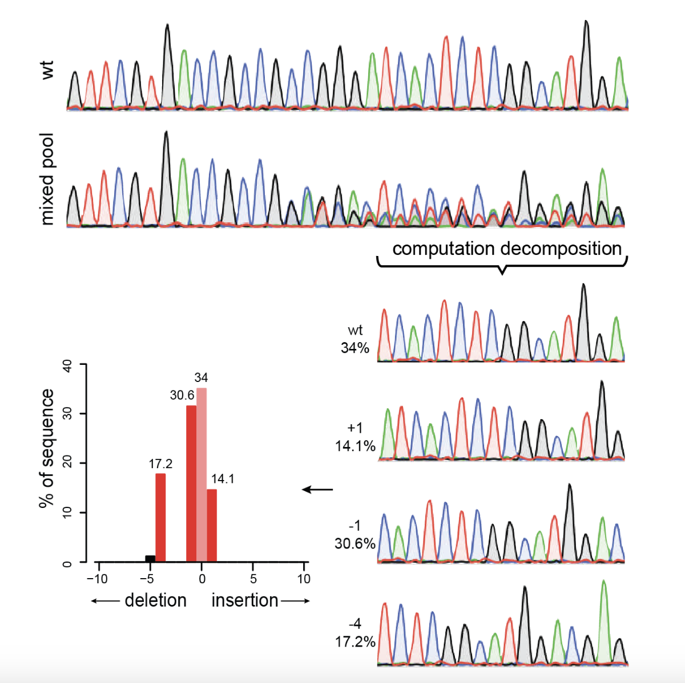
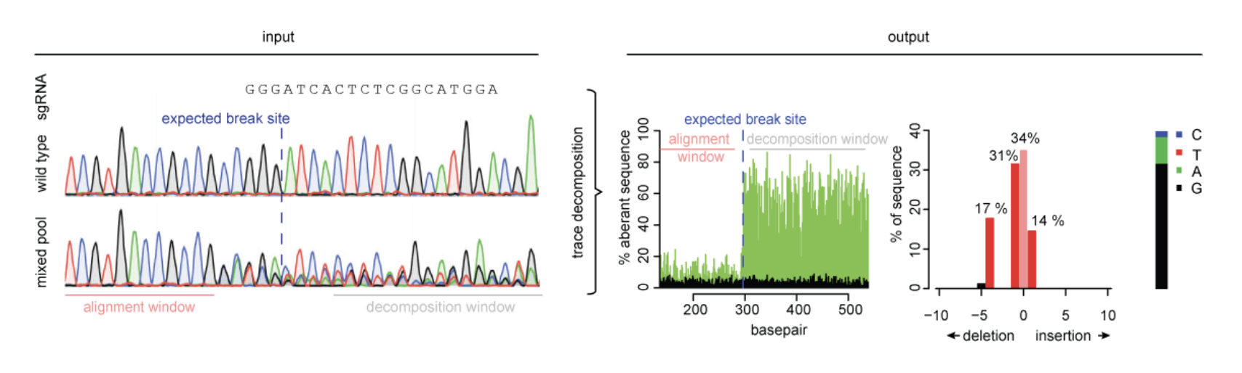
Understanding the outcomes of genome editing
TIDE – Tracking of Indels by Decomposition

Slide 15
Understanding the outcomes of genome editing
TIDE – Tracking of Indels by Decomposition
Let us analyze some of the data online

Slide 16
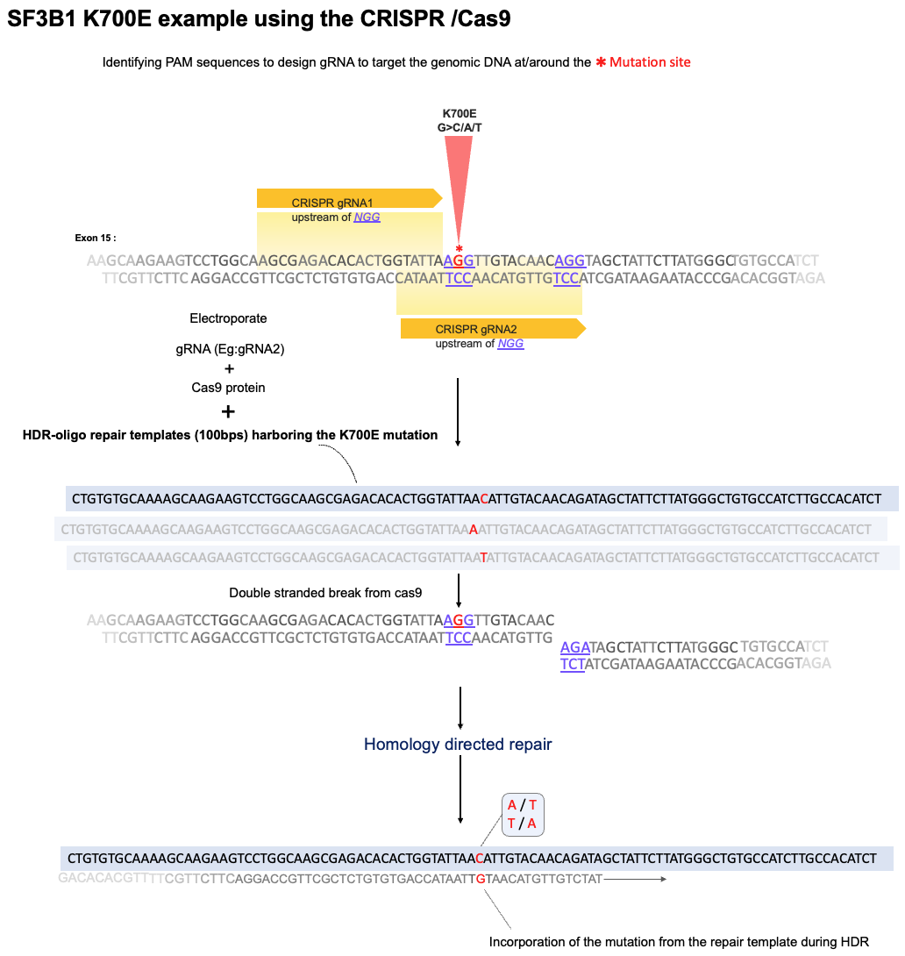
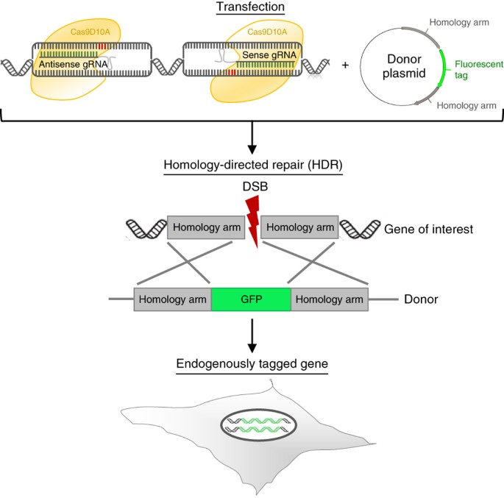
Determining knock-in/ nucleotide variations
Gene knock-in thorough HDR (Homology Directed “Repair)

Slide 17
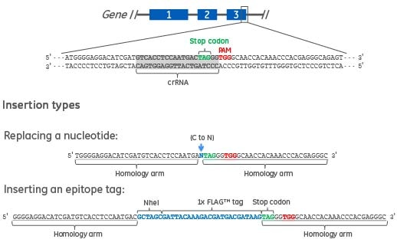
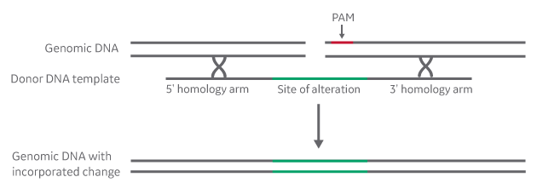
Determining knock-in/ nucleotide variations
SNP knock-in thorough HDR (Homology Directed Repair)
Example : Creating a base change in a gene
We perform the editing in cells and pick single clones of these edited cells to scrutinize for knock-in
Multiple rounds of preliminary QCs

Slide 18
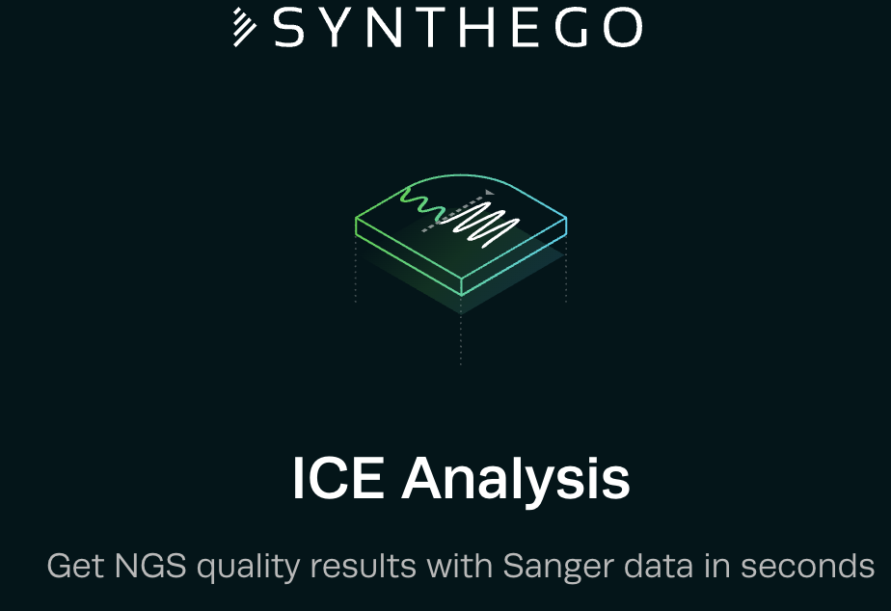
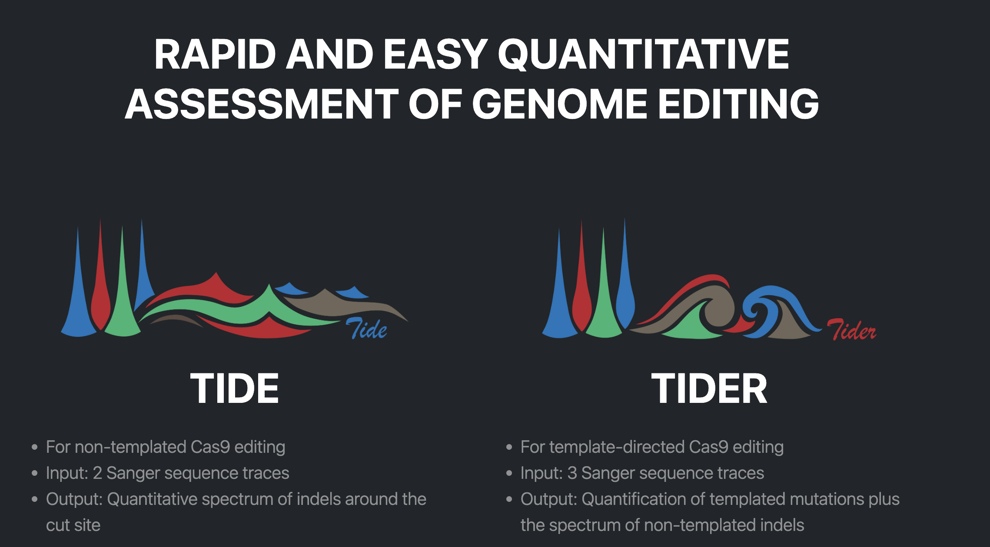
Determining knock-in/ nucleotide variations
SNP knock-in thorough HDR (Homology Directed Repair)
Example : Creating a base change in a gene
Editing and recombination efficiencies
- Assessed bulk edited population using
T7 endonuclease assay
TIDE /TIDER (Tracking of Indels – insertions/ deletions / recombinations)
T7 endonuclease assay
Lab based assay
PCR
T7 endonuclease enzyme
Run gel and assess editing efficiency
Indel tracking
Sanger Sequencing based assay
PCR
Send for sanger sequencing
Analyze through input of sequence files
Synthego : Inference of CRISPR Edits
https://ice.editco.bio/#/
TIDE :
https://tide.nki.nl/

Slide 19
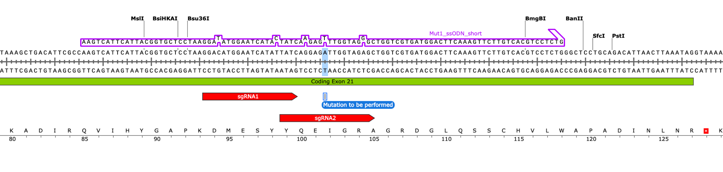
Determining knock-in/ nucleotide variations
SNP knock-in thorough HDR (Homology Directed Repair)
Example : Creating a base change in a gene
Editing and recombination efficiencies
Exon 21

Slide 20

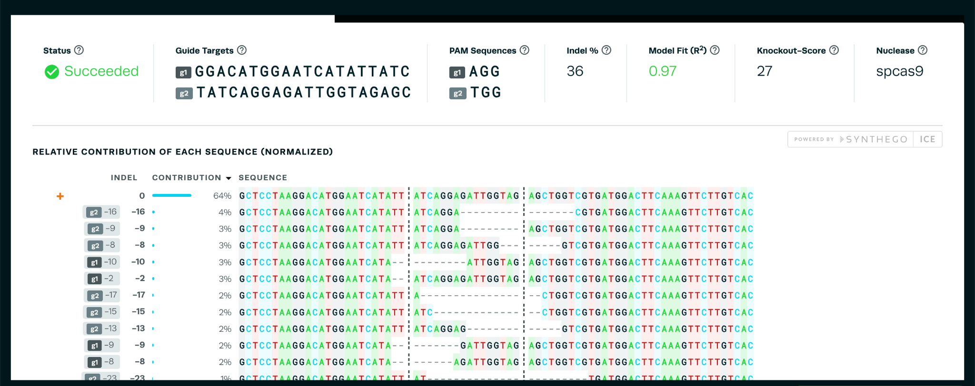
Determining knock-in/ nucleotide variations
SNP knock-in thorough HDR (Homology Directed Repair)
Example : Creating a base change in a gene

Slide 21
Understanding the outcomes of genome editing
Recombination events – Inference of CRISPR edits
Let us analyze some of the data online

Slide 22
Determining knock-in/ nucleotide variations
Gene knock-in thorough HDR (Homology Directed Repair)
Example : Tagging in a fluorescent reporter to DLX5 gene
We perform the editing in cells and pick single clones of these edited cells to scrutinize for knock-in
Multiple rounds of preliminary QCs
Process takes from anywhere from about 15 to 30 days to obtain an inserted/ knock-in line

Slide 23
Understanding the outcomes of genome editing
Tagging genes –
Let us analyze some of the data online

Slide 24
In Summary
We looked into
Understanding effects of double strand break created by Cas9
How can we
Analyse them
Quantify them
Use information to choose efficient guides - depends on cell lines / cell state
Use information to determine success rate of desired outcome
We also briefly discussed on
Understanding data coming out of sanger sequencing
Using sanger sequencing data to determine knock-in / SNP generation and gene-tagging
Various QC methods used at various stages of the process
Q and A – quiz format

Slide 25
Please contact wellcomeconnectingscience.org for more information.
Email : rs23@sanger.ac.uk

